Slide 1
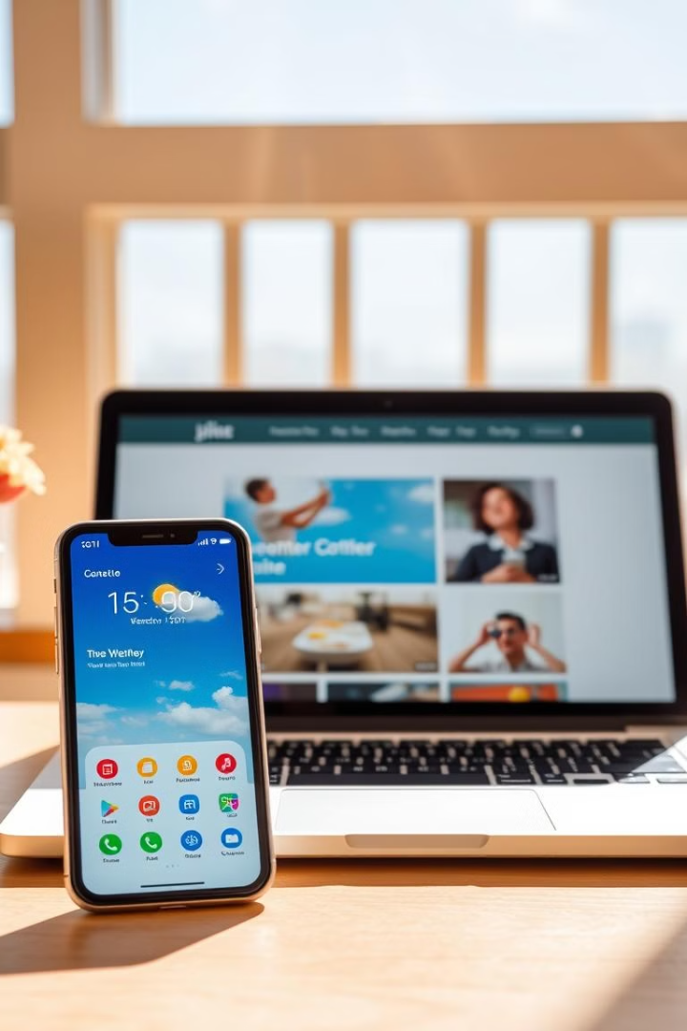
MLSA Full Stack Web Development: Weather App & Personal Website
Welcome! This presentation showcases two projects built using HTML, CSS, and JavaScript: a functional weather application and a visually appealing personal website. These projects demonstrate my skills in web development.
By Rachit Agarwal

Slide 2
HTML, CSS, and JavaScript: A Collaborative Trio
HTML: The Structure
CSS: The Styling
JavaScript: The Interactivity
Provides the fundamental structure and content of the webpage, using elements like headings, paragraphs, and images. It's the skeletal framework.
Handles the visual presentation, including colors, fonts, layout, and responsiveness. It's the aesthetic skin.
Adds dynamic behavior and interactivity, enabling features like user input, animations, and data fetching. It's the brain and muscle.

Slide 3
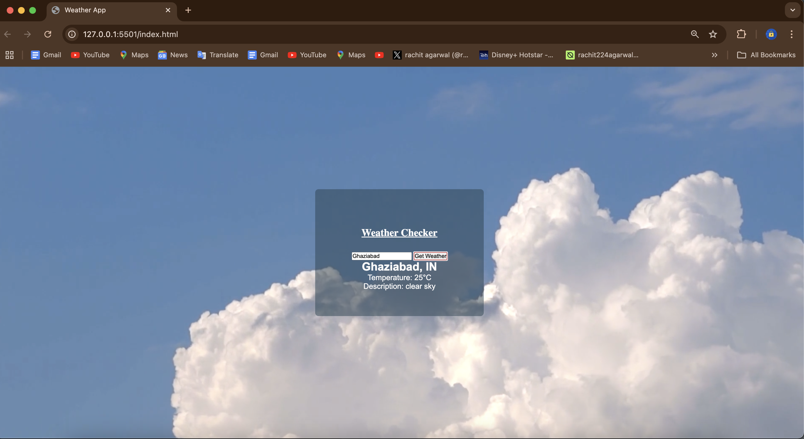
Key Features of the Weather App
Current Conditions
Displays real-time temperature and conditions.
When you enter City name it tells its temperature and Gives its description.

Slide 4
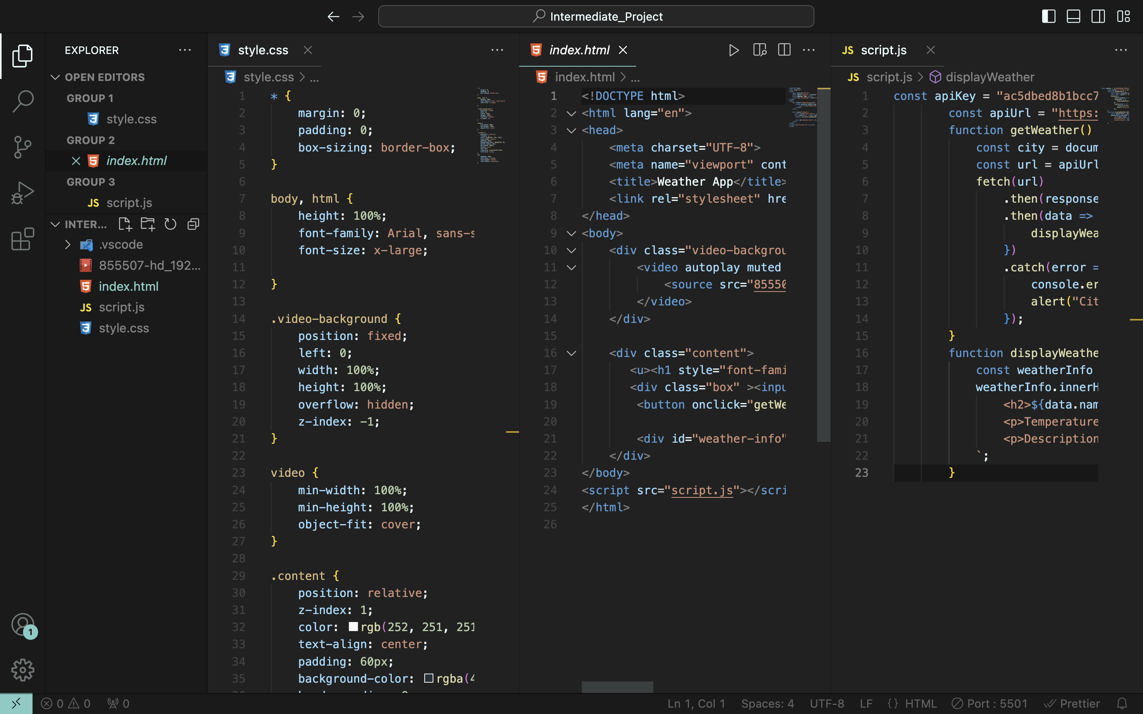
Weather App Demonstration
For my second project, I developed a weather web application that uses the OpenWeather API. In this project, I used HTML, CSS, and JavaScript to allow users to enter a location and get real-time weather information. The app displays current temperatures, weather conditions, and forecasts. Working on this project helped me learn how to connect to APIs and handle data, making my JavaScript skills much stronger.

Slide 5
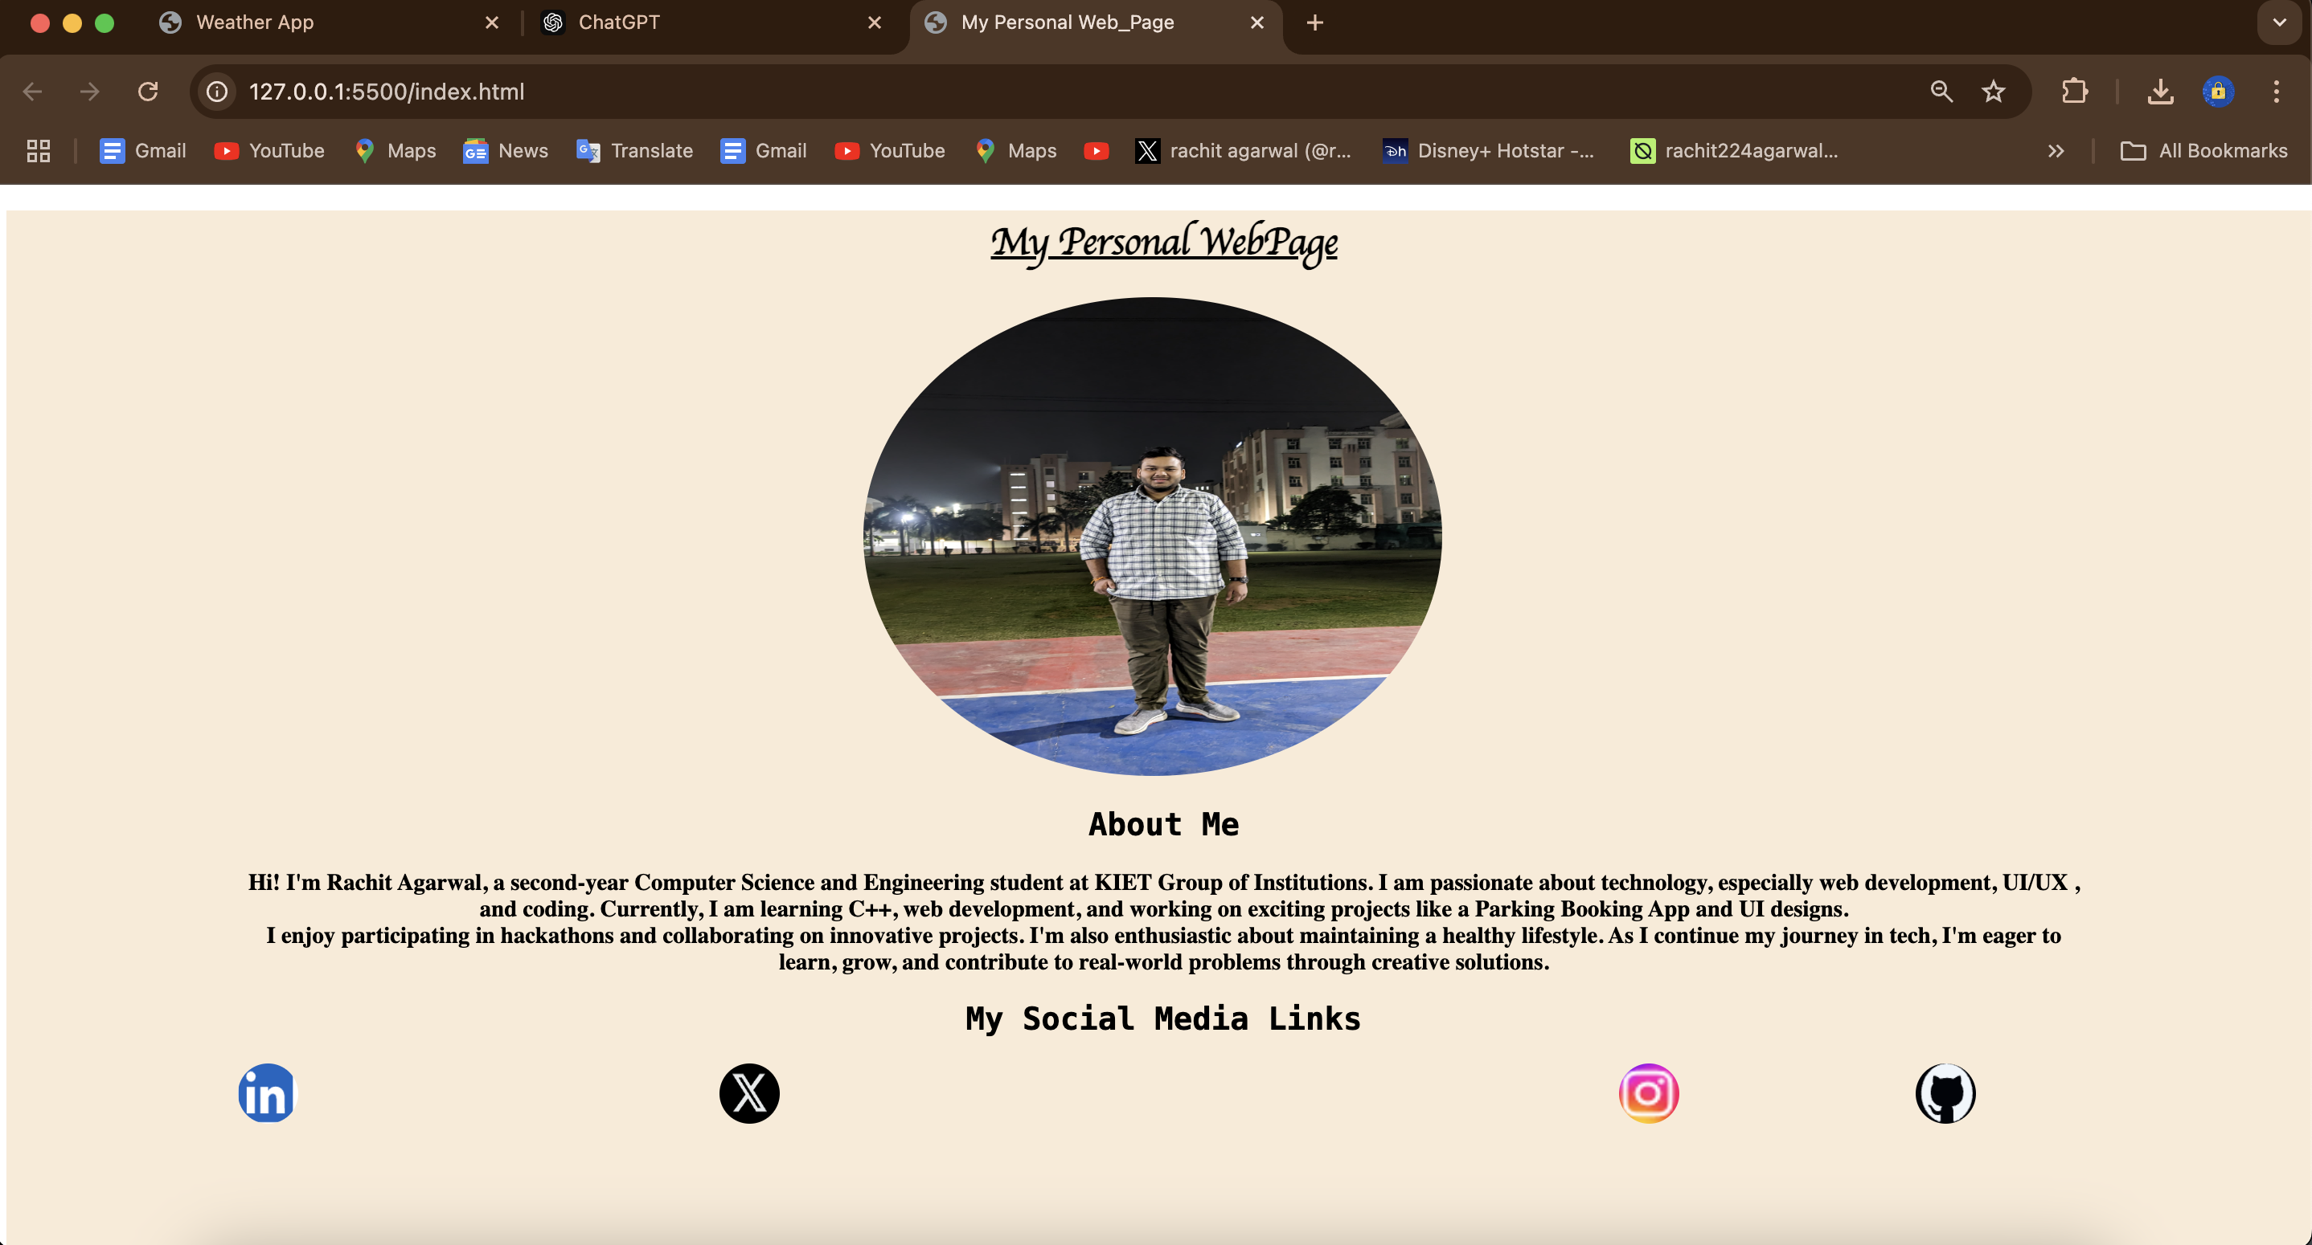
Overview of the Personal Webpage
Profile Photo
About Me
Contact
My profile photo image for better introducing me.
Highlights skills and experience. Engaging personal introduction.
Gives my social media links like Linkedin , Github and more

Slide 6

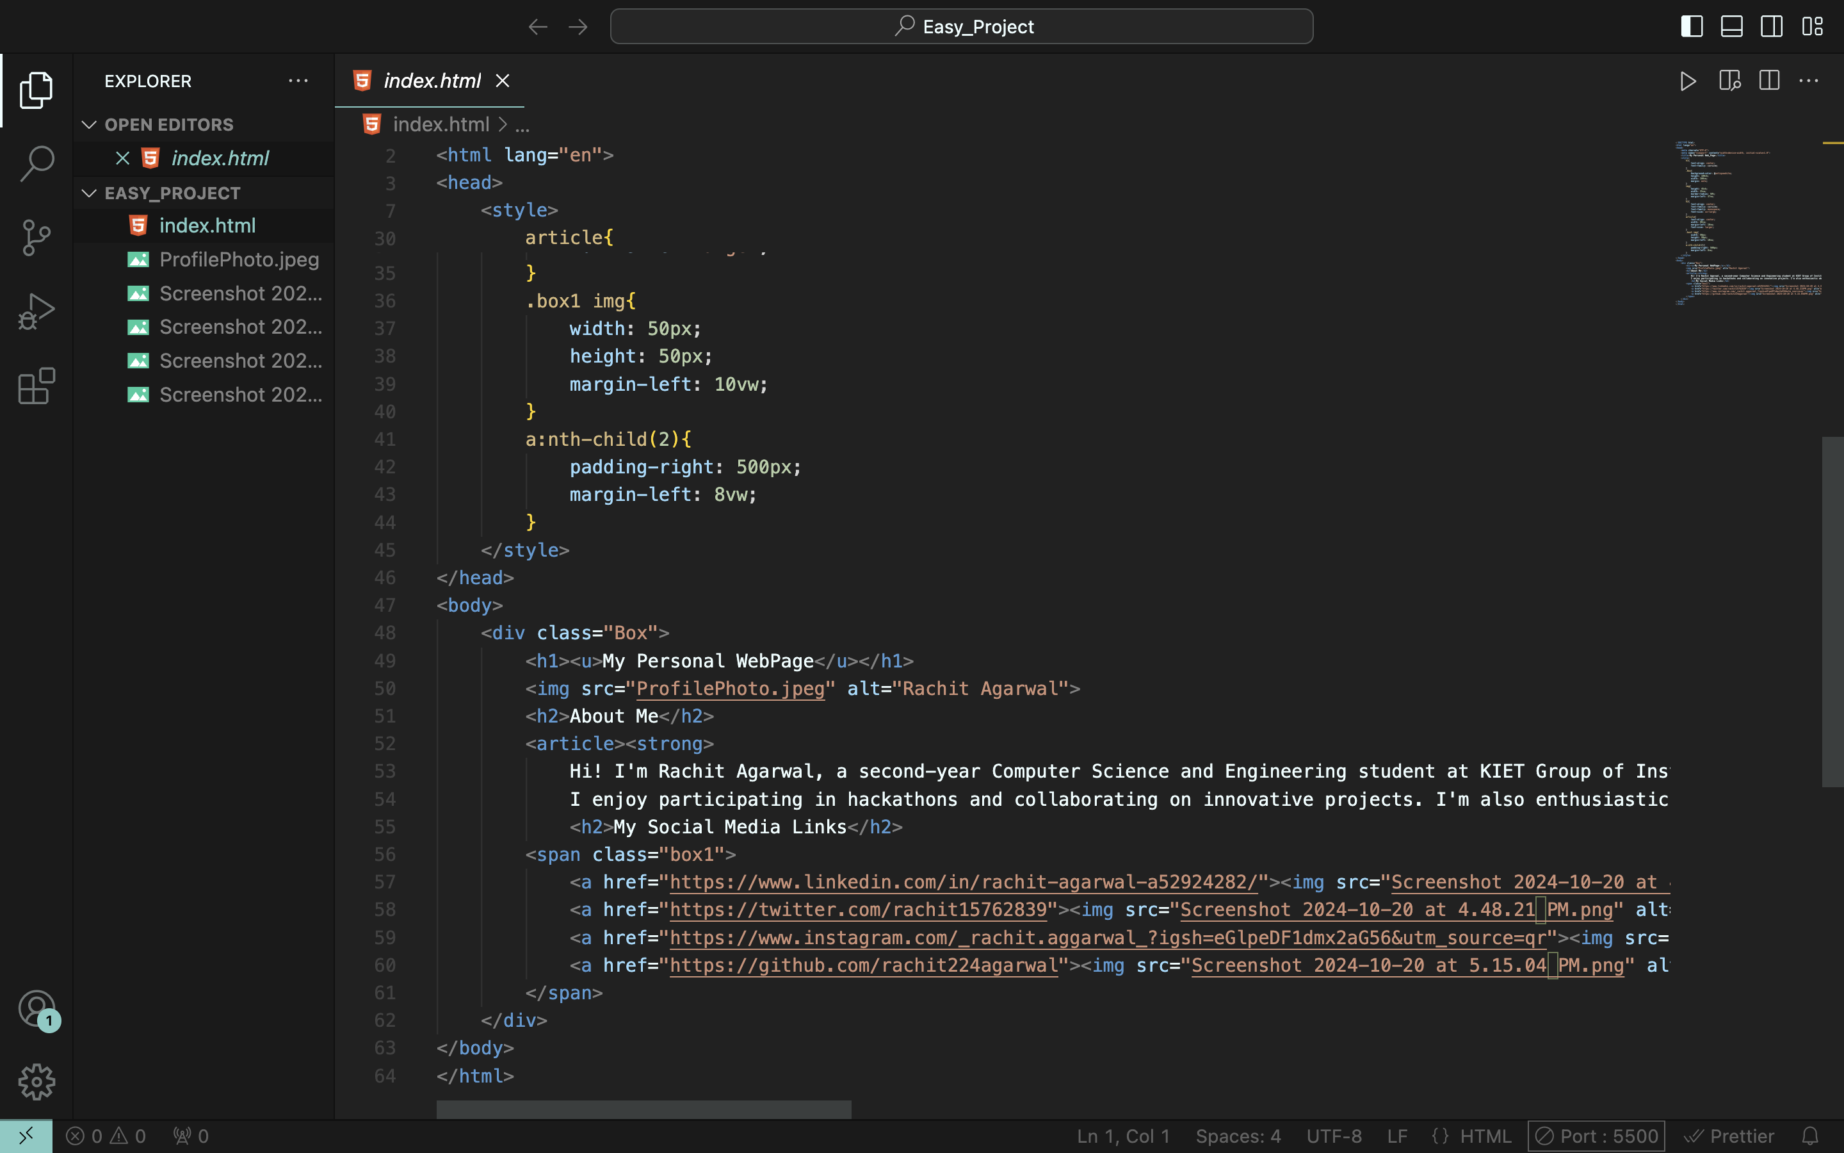



Personal Webpage Demonstration
Profile Photo
My profile photo image for better introducing me.
About Me
Highlights skills and experience. Engaging personal introduction
Social Media Links
Gives my social media links like Linkedin , Github and more

Slide 7

Conclusion
The MLSA internship has been an amazing experience for me. It helped me learn new skills and discover my passion for web development. I am excited to use what I learned to create more projects in the future. With the knowledge I gained, I look forward to exploring new opportunities in web development and making my mark in this field.

